Slide 1














Slide 2


Game Description
Start with $10,000
Ability to buy/sell stocks or crypto
The value of your asset changes after each turn
Simulates price change based on real life historical data
Learn about stocks/crypto and managing risk when investing
OBJECTIVE: MAKE AS MUCH MONEY AS POSSIBLE

Slide 3
Class Structure
ToTheMoon.java
Creates
Creates
PlayerAssets.java
AssetPrices.java

Slide 4
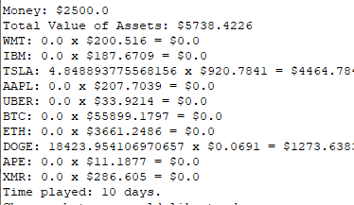
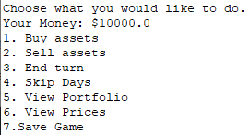
ToTheMoon class
Contains the main method
Creates the objects needed for the game
Asks the user what they would like to do during their turn

Slide 5
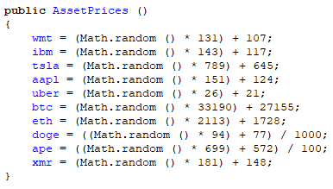
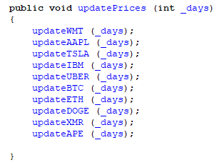
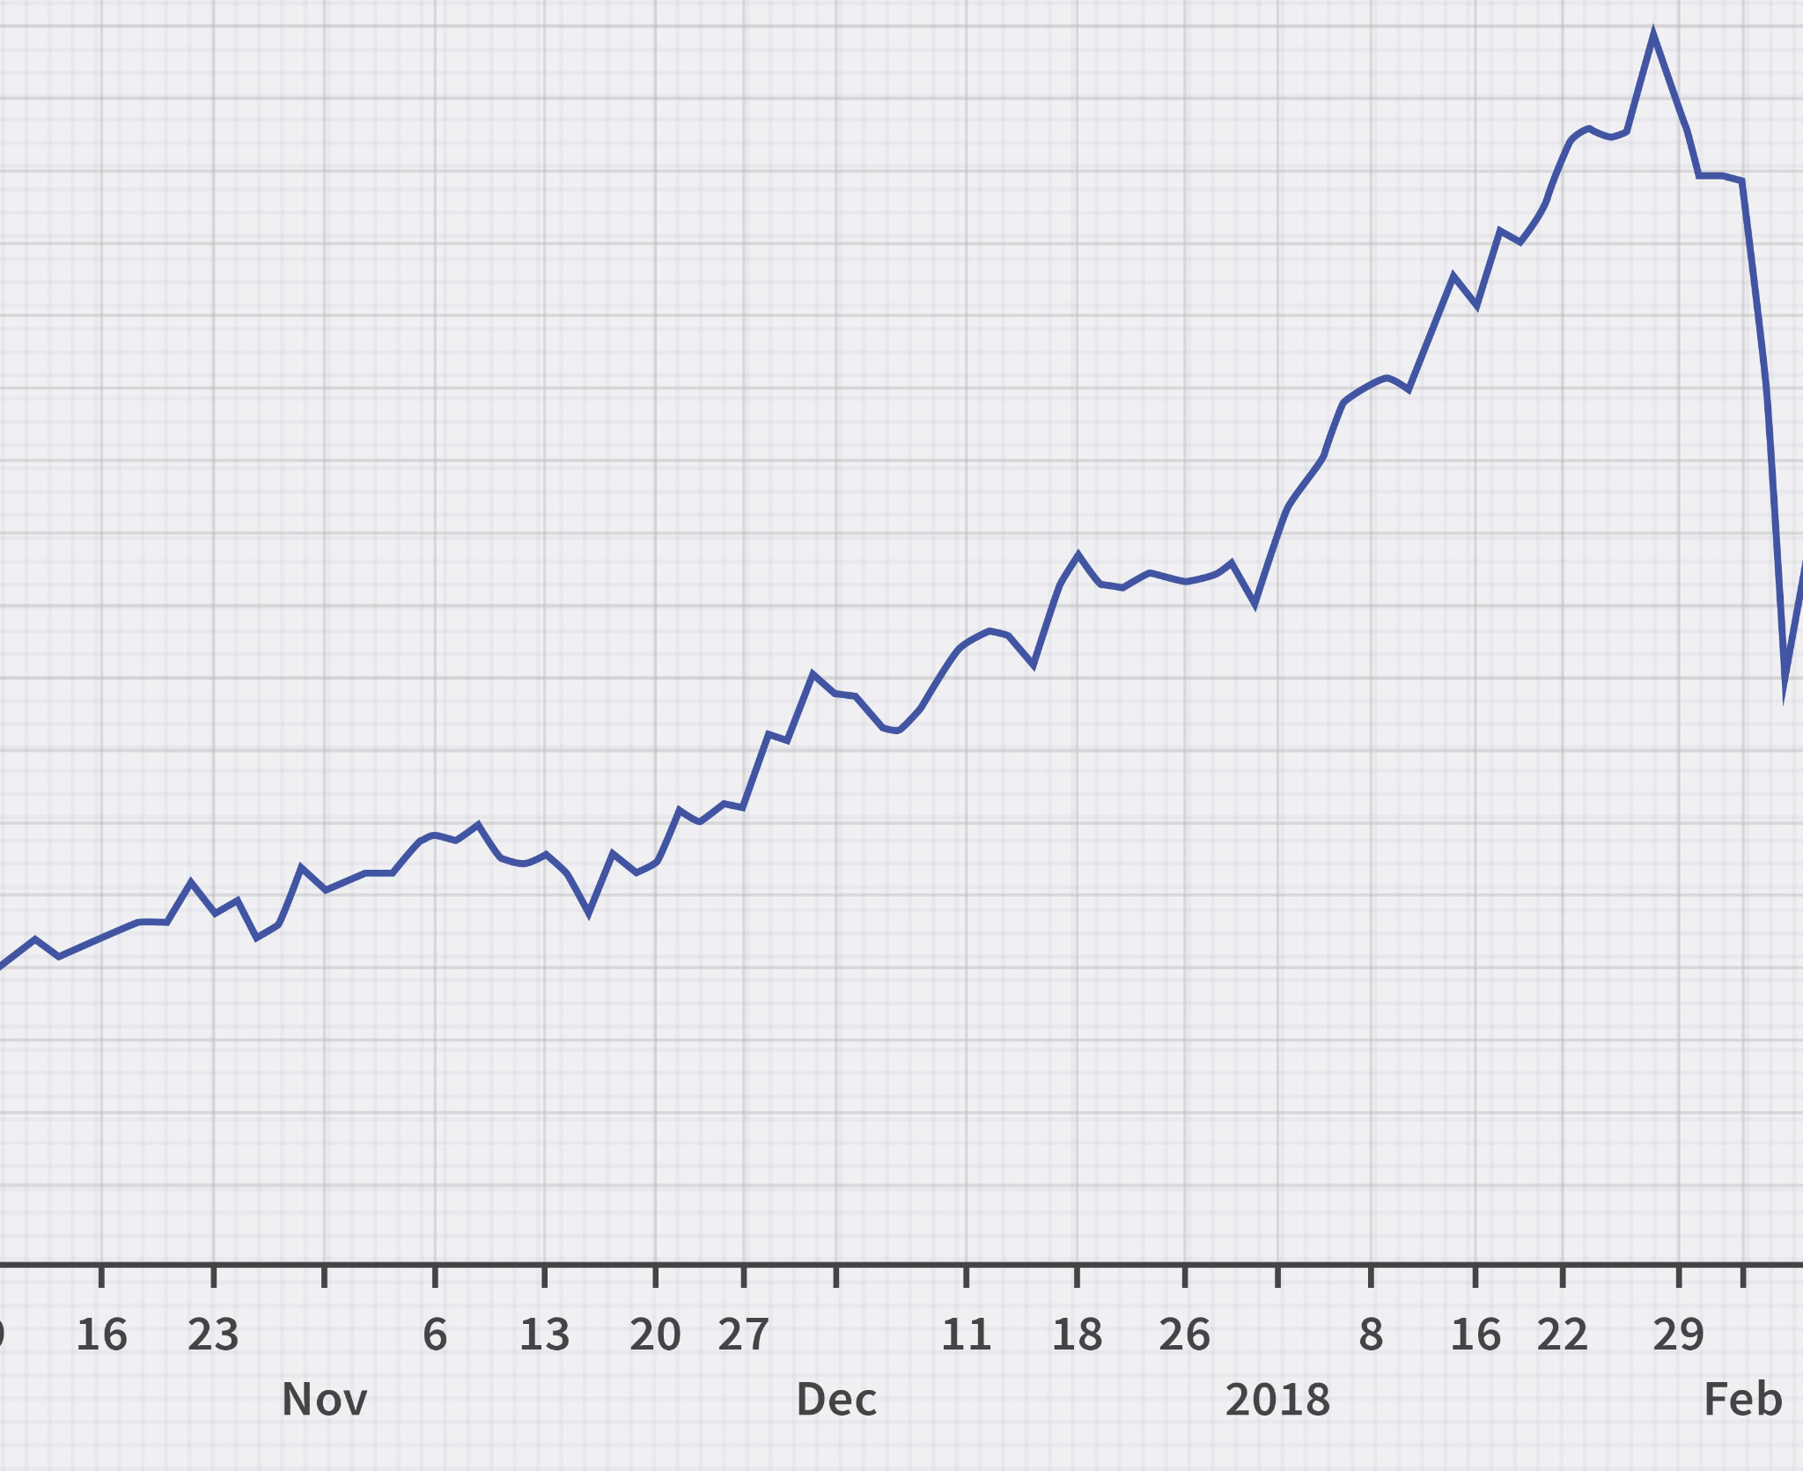
AssetPrices class
Generates the prices for each asset in the beginning of the game
Contains methods to update the price of each asset after each turn
Returns the value of each asset to the main method
Creates a chart to model the in-game price of an asset

Slide 6
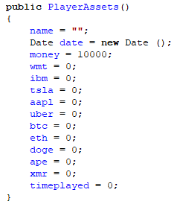
PlayerAssets class
Contains info about how much money the player has, and how much of each asset they have
Has methods to show the user what assets they own, how much money they have, and what their assets are worth.

Slide 7

Problems/Challenges
Finding a way to make the changes in price realistic
Generating price charts to model the price of an asset
Adding a way to save the game and load it again from a file

Slide 8
Price Generation
To determine what the price of the asset will be the next day, I used historical data for each asset to see how frequently the asset goes up or down by a certain amount.
Example:
Bitcoin went up by 0.3% to 3.4% from the previous day, 597/1825 times in the past 5 years.
597/1825 = 32.7%
Price in game will go up by 0.3 to 3.4%, 32.7% of the time.

Slide 9
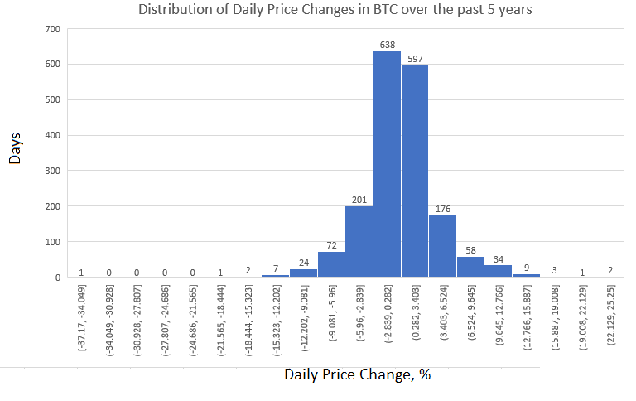

Slide 10
Flaws With This Way of Generating Prices
“Past performance is not indicative of future results”
Randomness can cause the asset to become worthless or hyperinflated
Predictable/Deterministic

Slide 11
